Slide 1
Blacktown Chinese Christian Church
Welcome to Our English Service 28.09.2025
English Service 9:45 – 11:00 am
Worship Songs: Passage: Speaker: Topic: Response Song: Announcements and Closing Prayer Benediction
My labour is not in vain In Christ alone Yet not I but through Christ in me Acts 17 Xavier Lakshmanan Paul the Apostle TBA

Slide 2
BCCC english service

Slide 3

Please keep all phones on silent

Slide 4
My Labour Is Not In Vain
CCLI Licence No: 5485849

Slide 5
My work in Christ is not in vain
My labor will not fail
For when I toil in Jesus’ name
His purpose will prevail

Slide 6
The tasks that You have set for me
I may not understand
Yet I will follow where You lead
I trust Your sovereign hand

Slide 7
So may all I do, be it great or small
Bring glory to Your name

Slide 8
In Your grace alone I will car – ry on
Your promise to me remains
My labour is not in vain

Slide 9
Go forth, You said, take up your cross
And set the captive free
So give me feet to seek the lost
Just as You searched for me

Slide 10
So may all I do, be it great or small
Bring glory to Your name

Slide 11
In Your grace alone I will car – ry on
Your promise to me remains
My labour is not in vain

Slide 12
Take heart, my soul, and persevere
Just as your Saviour did
For soon you will be home at rest
Your work, complete in Him

Slide 13
So may all I do, be it great or small
Bring glory to Your name

Slide 14
In Your grace alone I will car – ry on
Your promise to me remains
My labour is not in vain

Slide 15
So may all I do, be it great or small
Bring glory to Your name

Slide 16
In Your grace alone I will car – ry on
Your promise to me remains
My labour is not in vain

Slide 17
In Christ Alone
CCLI Licence No: 5485849

Slide 18
In Christ alone my hope is found
He is my light, my strength, my song
This Cornerstone, this solid Ground
Firm through the fiercest drought and storm

Slide 19
What heights of love, what depths of peace
When fears are stilled, when strivings cease
My comforter, my All in All
Here in the love of Christ I stand

Slide 20
In Christ alone, who took on flesh
Fullness of God in helpless babe
This gift of love and righteousness
Scorned by the ones He came to save

Slide 21
'Til on that cross as Jesus died
The wrath of God was satisfied
For every sin on Him was laid
Here in the death of Christ I live, I live

Slide 22
There in the ground His body lay
Light of the world by darkness slain
Then bursting forth in glorious day
Up from the grave He rose again

Slide 23
And as He stands in victory
Sin’s curse has lost its grip on me
For I am His and He is mine
Bought with the precious blood of Christ

Slide 24
No guilt in life, no fear in death
This is the power of Christ in me
From life’s first cry to final breath
Jesus commands my destiny

Slide 25
No power of hell, no scheme of man
Can ever pluck me from His hand
Til He returns or calls me home
Here in the power of Christ I’ll stand

Slide 26
Till He returns or calls me home
Here in the power of Christ I’ll stand
Here in the power of Christ we stand

Slide 27
Yet Not I But Through Christ In Me
CCLI Licence No: 5485849

Slide 28
What gift of grace is Jesus, my Redeemer
There is no more for heaven now to give
He is my joy, my righteousness and freedom
My steadfast love, my deep and boundless peace

Slide 29
To this I hold, my hope is only Jesus
For my life is wholly bound to His
Oh how strange and divine, I can sing "All is mine"
Yet not I, but through Christ in me

Slide 30
The night is dark but I am not forsaken
For by my side, the Savior He will stay
I labour on in weakness and rejoicing
For in my need, His power is displayed

Slide 31
To this I hold, my Shepherd will defend me
Through the deepest valley He will lead
Oh the night has been won and I shall overcome
Yet not I, but through Christ in me

Slide 32
No fate I dread, I know I am forgiven
The future sure, the price it has been paid
For Jesus bled and suffered for my pardon
And He was raised to overthrow the grave

Slide 33
To this I hold, my sin has been defeated
Jesus now and ever is my plea
All the chains are released, I can sing "I am free"
Yet not I, but through Christ in me

Slide 34
With every breath, I long to follow Jesus
For He has said that He will bring me home
And day by day, I know He will renew me
Until I stand with joy before the throne

Slide 35
To this I hold, my hope is only Jesus
All the glory evermore to Him
When the race is complete, still my lips shall repeat
"Yet not I, but through Christ in me"

Slide 36
When the race is complete, still my lips shall repeat
"Yet not I, but through Christ in me"
"Yet not I, but through Christ in me"
"Yet not I, but through Christ in me"

Slide 37
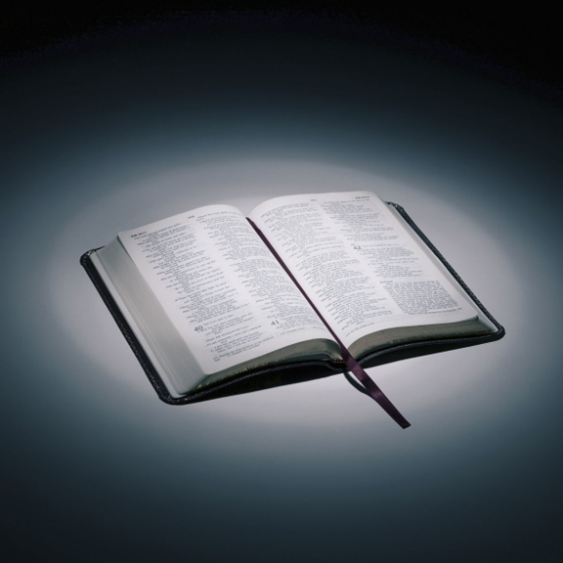
Bible reading

Slide 38
Acts 17
When Paul and his companions had passed through Amphipolis and Apollonia, they came to Thessalonica, where there was a Jewish synagogue. ² As was his custom, Paul went into the synagogue, and on three Sabbath days he reasoned with them from the Scriptures,

Slide 39
Acts 17
³ explaining and proving that the Messiah had to suffer and rise from the dead. “This Jesus I am proclaiming to you is the Messiah,” he said. ⁴ Some of the Jews were persuaded and joined Paul and Silas, as did a large number of God-fearing Greeks and quite a few prominent women.

Slide 40
Acts 17
⁵ But other Jews were jealous; so they rounded up some bad characters from the marketplace, formed a mob and started a riot in the city. They rushed to Jason’s house in search of Paul and Silas in order to bring them out to the crowd. ⁶ But when they did not find them, they dragged Jason and some other believers before the city officials, shouting: “These men who have caused trouble all over the world have now come here,

Slide 41
Acts 17
⁷ and Jason has welcomed them into his house. They are all defying Caesar’s decrees, saying that there is another king, one called Jesus.” ⁸ When they heard this, the crowd and the city officials were thrown into turmoil.

Slide 42
Acts 17
⁹ Then they made Jason and the others post bond and let them go.
¹⁰ As soon as it was night, the believers sent Paul and Silas away to Berea. On arriving there, they went to the Jewish synagogue.

Slide 43
Acts 17
¹¹ Now the Berean Jews were of more noble character than those in Thessalonica, for they received the message with great eagerness and examined the Scriptures every day to see if what Paul said was true. ¹² As a result, many of them believed, as did also a number of prominent Greek women and many Greek men.

Slide 44
Acts 17
¹³ But when the Jews in Thessalonica learned that Paul was preaching the word of God at Berea, some of them went there too, agitating the crowds and stirring them up. ¹⁴ The believers immediately sent Paul to the coast, but Silas and Timothy stayed at Berea.

Slide 45
Acts 17
¹⁵ Those who escorted Paul brought him to Athens and then left with instructions for Silas and Timothy to join him as soon as possible.
¹⁶ While Paul was waiting for them in Athens, he was greatly distressed to see that the city was full of idols.

Slide 46
Acts 17
¹⁷ So he reasoned in the synagogue with both Jews and God-fearing Greeks, as well as in the marketplace day by day with those who happened to be there. ¹⁸ A group of Epicurean and Stoic philosophers began to debate with him. Some of them asked, “What is this babbler trying to say?” Others remarked, “He seems to be advocating foreign gods.” They said this because Paul was preaching the good news about Jesus and the resurrection.

Slide 47
Acts 17
¹⁹ Then they took him and brought him to a meeting of the Areopagus, where they said to him, “May we know what this new teaching is that you are presenting? ²⁰ You are bringing some strange ideas to our ears, and we would like to know what they mean.”

Slide 48
Acts 17
²¹ (All the Athenians and the foreigners who lived there spent their time doing nothing but talking about and listening to the latest ideas.)
²² Paul then stood up in the meeting of the Areopagus and said: “People of Athens! I see that in every way you are very religious.

Slide 49
Acts 17
²³ For as I walked around and looked carefully at your objects of worship, I even found an altar with this inscription: to an unknown god. So you are ignorant of the very thing you worship—and this is what I am going to proclaim to you.
²⁴ “The God who made the world and everything in it is the Lord of heaven and earth and does not live in temples built by human hands.

Slide 50
Acts 17
²⁵ And he is not served by human hands, as if he needed anything. Rather, he himself gives everyone life and breath and everything else. ²⁶ From one man he made all the nations, that they should inhabit the whole earth; and he marked out their appointed times in history and the boundaries of their lands.

Slide 51
Acts 17
²⁷ God did this so that they would seek him and perhaps reach out for him and find him, though he is not far from any one of us. ²⁸ ‘For in him we live and move and have our being.’ As some of your own poets have said, ‘We are his offspring.’

Slide 52
Acts 17
²⁹ “Therefore since we are God’s offspring, we should not think that the divine being is like gold or silver or stone—an image made by human design and skill. ³⁰ In the past God overlooked such ignorance, but now he commands all people everywhere to repent.

Slide 53
Acts 17
³¹ For he has set a day when he will judge the world with justice by the man he has appointed. He has given proof of this to everyone by raising him from the dead.”
³² When they heard about the resurrection of the dead, some of them sneered, but others said, “We want to hear you again on this subject.”

Slide 54
Acts 17
³³ At that, Paul left the Council. ³⁴ Some of the people became followers of Paul and believed. Among them was Dionysius, a member of the Areopagus, also a woman named Damaris, and a number of others.

Slide 55
Announcements

Slide 56





Account name: Blacktown Chinese Christian Church
Account number: 4216 50263
Offering
BSB: 112 - 879
Please put in "offering" as the reference
The offering box is available at the back of the hall

Slide 57
Prayer points

Slide 58
Mingle time!

